Slide 1
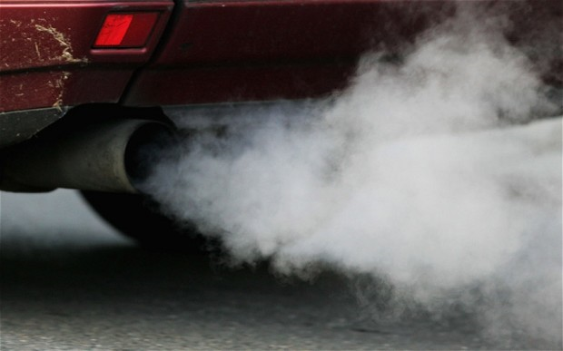
Background to Atmospheric Pollution
Anup Bhatt

Slide 2
Main Species
Nitrogen oxides (NO_{x})
Carbon monoxide (CO)
Sulphur dioxide (SO₂)
Volatile organic compounds (VOCs), such as benzene and isoprene
Particulate matter (PM_{2.5} and PM₁₀)
Sulphur dioxide
Benzene
Isoprene

Slide 3
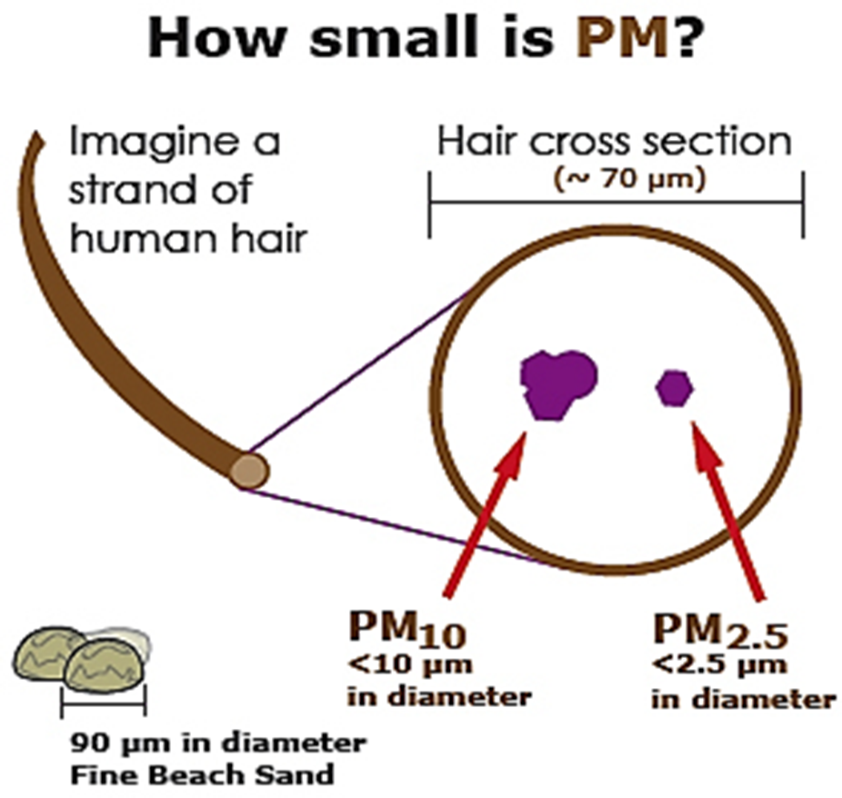
Particulate Matter (PM)
Particulate matter is collection of small solid or liquid particles suspended in the atmosphere.
PM can be separated into two distinct categories, primary and secondary particles.
Fine PM consists of particles having a diameter of between 0.1 and 2.5 μm and this is designated PM_{2.5}.
PM₁₀ denotes all ambient PM having a diameter of 10 μm or less.

Slide 4
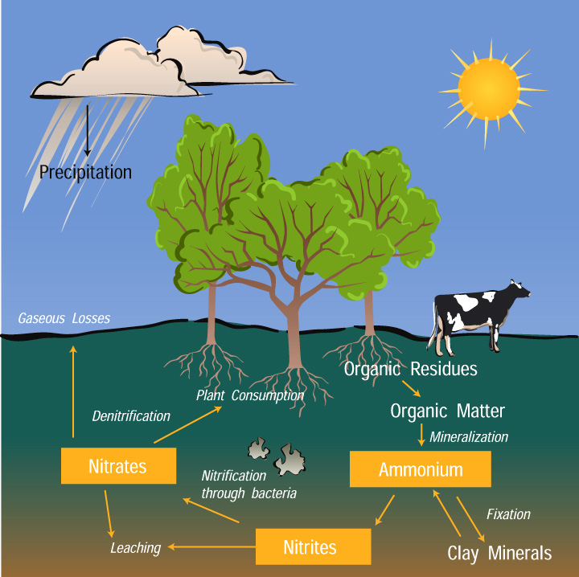
Nitrogen Oxides (NO_{x})
Nitrogen dioxide
Nitrogen oxides (NO_{x}) contribute to several environmental problems such as acid rain, smog formation and ozone layer depletion.
Nitric oxide (NO) and nitrogen dioxide (NO₂) are collectively known as NO_{x} and they are formed from by the combustion of biomass and fossil fuels.
NO_{x} are also produced by natural processes such as lightning, volcanic activity and oxidation of ammonia via the nitrogen cycle.

Slide 5
Stratospheric vs. tropospheric ozone
Ozone
Stratospheric ozone | Tropospheric ozone
“Good” | “Bad”
12- 50 km above the Earths surface | Extends from the Earths surface to a height of about 12 km
Shields the Earth from damaging ultraviolet (UV) light | Ozone existing at ground level in the troposphere is harmful to humans
Protects both plants and animals from the harmful UV rays from the sun | Causes numerous health effects such as chest pain, coughing, throat irritation and inflammation
Notes:
During the day, NO2 is photolysed by ultraviolet (UV) light to give NO and an oxygen atom (O). The oxygen atom combines with oxygen to form ozone (O3).
Ozone in the stratosphere shields the Earth from damaging UV light, benefiting both plants and animals.
Conversely, ozone existing at ground level in the troposphere is harmful because it causes numerous health effects such as coughing, throat irritation and inflammation of the airways.

Slide 6
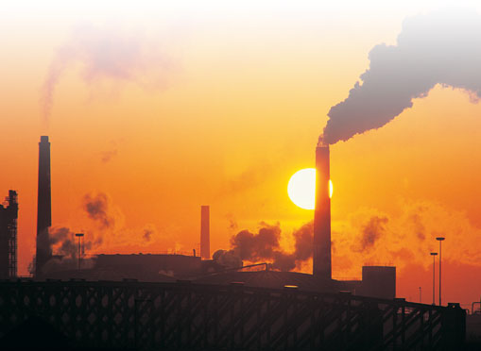
How air pollution is linked with the climate
The primary human cause of climate change is the burning of fossil fuels.
A secondary leading cause that releases methane into the atmosphere is intensive agriculture.
Carbon dioxide (CO) is the principle greenhouse gas produced from fossil fuels (methane is also released).
These gases rise in the atmosphere and prevent the suns heat which has already reached from dissipating.

Slide 7
Measurements
Jaeyoung Lee

Slide 8
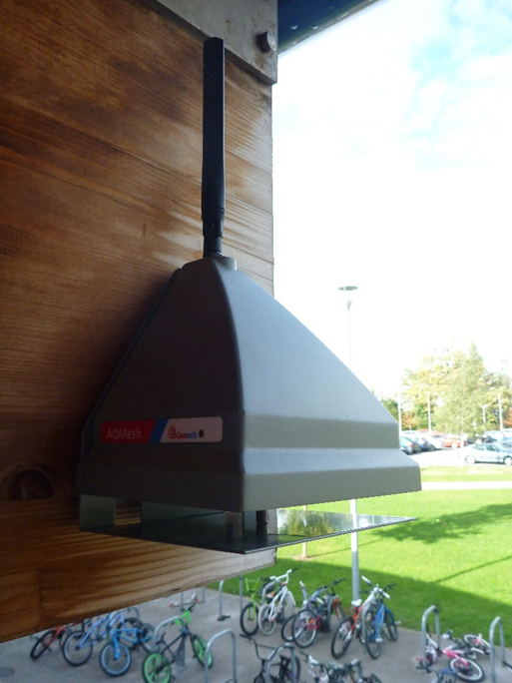
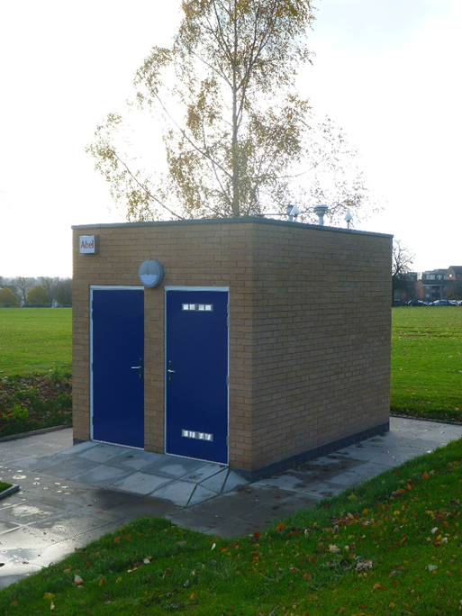

Instruments
AQMesh
AURN
CanarIT

Slide 9
Weekdays vs. Weekends

Slide 10
Diurnal cycle

Slide 11
Leicester vs. South Wigston vs. London
 | South Wigston | Leicester | London
O₃ (ppb) | 16.9 | 12.8 | 4.6
NO (ppb) | 11.81 | 13.7 | 152.5

Slide 12
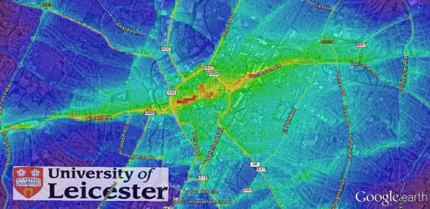
Hot spots from models and flight measurements
(Roland Leigh and Antoine Jeanjean)
Notes:
Modelled data produced by the Airviro model and overlaid onto Google Earth. The dominant role of roads in nitrogen dioxide emissions can be clearly seen, including contributions from the M1 to the west of Leicester.

Slide 13
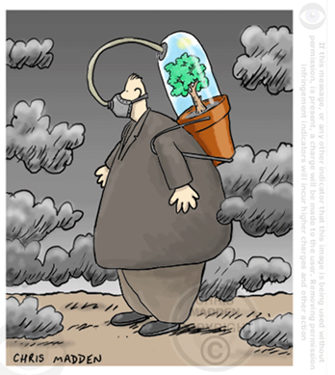
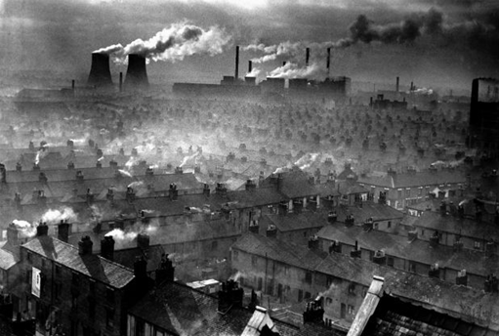
Hourly mean
 | Leicester | Birmingham | Nottingham | Coventry
Nitrogen Dioxide (µg/m3) | 24 | 42 | 24 | 15
PM 2.5 (µg/m3) | 10 | 5 | 5 | 6

